Slide 1


Chatbot Teaching Assistant
Status Update #1: 2022-02-07
* Lockheed Martin liaison
Sponsor Mentors: Evan J. Dodge & company
Project Engineer: Junichi Kanai
Chief Engineer: Nima Ahmadi
Name​ | Grad. | Major​
Jonah Que​ | May 2022​ | Computer & Systems Engineering​
Roland Rao​ | May 2022​ | Computer Science / Computer & Systems Engineering​
William Thramann​ | May 2022​ | Industrial Systems and Managerial Engineering ​
Zhuoming Wu​ | May 2022​ | Electrical Engineering​
Leyang Zhang​ | May 2022​ | Computer & Systems Engineering​
Sandor Magyar*​ | May 2022​ | Computer & Systems Engineering​ / Computer Science​
Megan Stahl​ | May 2022​ | Computer & Systems Engineering​
Mitesh Kumar​ | May 2022​ | Computer Science / Computer & Systems Engineering​
Zachary Johnson​ | May 2022​ | Computer & Systems Engineering​

Slide 2
Project Description Recap
Goal:
Create a working chatbot that can provide meaningful information for students and faculty.
Gather raw text data from lengthy course web page into knowledge base
Answer general questions and provide relevant links to the course page

Slide 3
Agenda
Project description recap
Customer needs and engineering specifications
Concept generation
Current work
System architecture
Hosting & backend
Q&A subsystem
EDN wiki text scraper
Unstructured text storage
Vector representations of words
BERT question and answer model
Remote Virtual Machine
Next steps
Connect React Frontend to Python backend for alpha testing
Database logging for all queries
Analytics on database for performance improvement and query categorization

Slide 4
Intended User Base and Potential Issues
Students of the EDN
Table 1: Potential issues and assigned priorities
Potential Issue | Impact Level(1-3) | Probability(1-3) | Priority
EDN is slow to navigate | 3 | 3 | High
EDN is difficult to navigate | 3 | 1 | Medium
Professors cannot effectively monitor EDN usage difficulties | 1 | 1 | Low

Slide 5
Customer Needs and Engineering Requirements Highlights of Table 2 below
Low frequency of unusable answers
Ease of use for the student
Observable benefits as opposed to searching wiki pages manually
Effective administrative toolset for instructors

Slide 6
Table 2: Customer needs and associated requirements
Need # | Customer Need | Priority | Req # | Project Requirement / Description / Metric | Value(s) / Range | Units | Constraint
1 | There must be a loose way to interact with the chatbot (i.e., no strict format required for queries) | High | 1.1 | System correctly decides whether 80% of user queries are answerable | [0, 100] | % | ≥ 80%
 |  |  | 1.2 | System gives a satisfactory answer to 50% of answerable queries | [0, 100] | % | ≥ 50%
 |  |  | 1.3 | F1-score is above 80% | [0, 100] | % | ≥ 70%
 |  |  | 1.4 | System is convenient to use for 90% of users | [0, 100] | % | ≥ 90%
2 | Instructors should be able to access a history of student queries | Low | 2.1 | System can handle 100 simultaneous users | [0, ∞) | Users | ≥ 100
 |  |  | 2.2 | Instructor can see student queries within 10 minutes after they are submitted | [0, ∞) | Minutes | ≤ 10
 |  |  | 2.3 | Instructor can see up to 100 entries in the log at a time | [0, ∞) | Entries | ≤ 100
3 | The system should be quick to use |  | 3.1 | Total time to get a response is less than a minute | [0, ∞) | Minutes | ≤ 1
 |  |  | 3.2 | Only the top 5 relevant pages should be displayed | [0, ∞) | Pages | ≤ 5
 |  |  | 3.3 | A sample of common questions take less time to answer with the bot than with just the EDN | [0, ∞) | Minutes | < time needed with EDN
4 | Students want information about their Project and Chief Engineers |  | 4.1 | System must have access to current PE and CE listings
 |  |  | 4.2 | System must modify querries for PE and CE information based on Capstone Project
5 | Chatbot needs information from wiki pages |  | 5.1 | Chatbot needs to be able to scrape information off of the wiki and store it in a database in order to be indexed
 |  |  | 5.2 | Database provides information such as the text around the query hit and a link to the page the query hit was found on
6 | An admin traffic analysis |  | 6.1 | collect user traffic on what information is requested the most - categorized - for future improvement. | [0, ∞) | categories | >10

Slide 7
Concept Selection Highlights of Table 3 below
Ease of Implementation
5 week project timeline
Performance
Gauge machine learning model performance by accuracy
Gauge system performance by response times
Client resource usage

Slide 8
Table 3: Concept Selection
Associated Need(s) | Concept Name | Concept Description | Name(s) | Ease of Implementation | Performance | Resource efficiency | Total | Select (Y/N)
1 | Keyword Search | If the user query has no matching keywords to the EDN website, then it is most likely an un-answerable question. Utilize a full text search database in order to search relevant pages of text by keyword | Mitesh Kumar | 10 | 10 | 10 | 30 | Y
1 | Convolutional Neural Network | Instead of using BERT, implement our own deep learning network architecture to answer questions based on relevant text | Leyang Zhang | 0 | 2 | 10 | 12 | Maybe
1 | BERT architecture | Utilize BERT deep learning network architecture to answer questions based on relevant text | Mitesh Kumar | 2 | 5 | 10 | 17 | N
1 | Deeppavlov Library | Instead of fine-tuning the BERT model, use the Deeppavlov library that is fine tuned out of the box | Mitesh Kumar | 10 | 8 | 10 | 28 | Y
1 | BERT large | Bert large variant architecture has more parameters and is thus more expensive to train and operate, but is more accurate. Notably, it performs significantly better when the fine tuning dataset size is small. | Mitesh Kumar | 2 | 10 | 3 | 12 | Y
1 | BERT small | Bert small variant architecture has fewer parameters and is thus less expensive to train and operate, but also less accurate | Mitesh Kumar | 2 | 2 | 5 | 9 | N
1 | spaCy | The spaCy python library provides a tool to extract common keywords from a string of text. We can use this to extract keywords from search queries before passing them to the keyword search concept. | Mitesh Kumar | 10 | 10 |  | 20 | Y
1 | Vector representation | Utilize word vector representation so that we can categorize tokens into the word they actually mean. For example | Leyang Zhang | 5 | 10 |  | 15 | Maybe

Slide 9
Table 4: Concept Selection (cont.)
Associated Need(s) | Concept Name | Concept Description | Name(s) | Ease of Implementation | Performance | Resource efficiency | Total | Select (Y/N)
2 | Distributed REST API | Distribute the question and answer workload onto several rest APIs to increase request bandwidth | Mitesh Kumar | 0 | 5 | 10 | 15 | N
2 | Single REST API | Utilize a single server to run the question and answer workload to improve response time | Mitesh Kumar | 10 | 10 | 7 | 27 | Y
2 | Paginated SQL query | Instructor UI isn't burdened with storing all of the responses. Instead, the database can send X amount of responses at a time. | Mitesh Kumar | 2 | 10 | 5 | 17 | Maybe
2 | Select * from SQL query | Send all the responses to the UI at once. This is simpler to implement. | Mitesh Kumar | 10 | 0 | 10 | 20 | Y
3 | Answer + relevant pages | The chatbot will provide a phrase that answers the user's question as well as relevant pages to supplement the answer. | Sandor Magyar | 9 | ? | 0 | ≥ 9 | Y
3 | Deploy on Webex | Students interact with bot by direct messaging or mentioning it in the Webex app | Sandor Magyar | 8 | 9 | 8 | 25 | Y
3 | Integrate into EDN | Students interact with bot through an interface built into EDN | Sandor Magyar | 0 | 10 | 0 | 10 | N
3 | Deploy on standalone site | Students interact with bot on its own interactive webpage | Sandor Magyar | 4 | 7 | 5 | 16 | N
3 | Activate with HTTP webhook | Webex servers perform HTTP request to bot when messages arrive | Sandor Magyar | 7 | 6 | 5 | 18 | Still deciding
3 | Activate with WebSocket | Webex servers notify bot of messages on direct persistent TCP connection | Sandor Magyar | 9 | 7 | 7 | 23 | Still deciding

Slide 10
Current Work

Slide 11


System architecture
2
Webex servers
3
Our server
Server code
Webex client
Q&A subsystem
4
User types message
1
Analytics subsystem
Bot responds
5

Slide 12
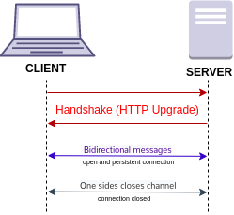
Hosting & Backend
Setting up the WebSocket protocol, starting from HTTP
CC BY-SA 4.0
Author: Brivadeneira
Got server up and running on RPI Design Lab internal server
We plan to host Python or JavaScript code here to connect to the Webex cloud APIs
Those languages have many Webex bot libraries
Server can connect to Webex through either HTTP or WebSocket
WebSocket is a direct, private TCP connection between servers. It may be more efficient because no HTTP session has to be created and destroyed on each chat message to the bot. Created successful basic WebSocket bot.
HTTP bot must be at a publicly accessible IP address, which we can do

Slide 13
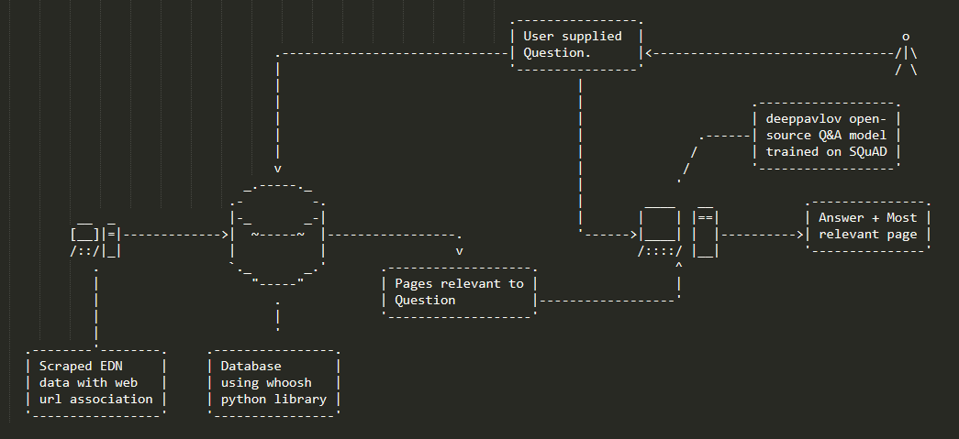
Q&A Sub-System Architecture
Whoosh database
Keyword search
Deeppavlov library
Fine tuned BERT model
Figure 1: Architecture of the Question Answering sub-system

Slide 14
Project Status
Health | Deliverable | Plan Due Date | Planned / Actual Completion Date | Status Explanation
 | Question and Answer test | 2/9 | 2/9 | Provides direct answer to most reasonable questions, as well as relevant pages.
 | Question and Answer REST API | 2/14 |  | HTTP request mangles string formatting and deforms Q&A bot response, but otherwise works fine
Legend
Green = Good
Yellow = At Risk
Red = In Trouble

Slide 15

EDN Scraper
Uses Selenium
Scrapes the Capstone Support wiki
Login Capabilities
Saves website text and link to page as a json
Scrape other projects
Scrape the forum

Slide 16
Unstructured Text Storage
Whoosh Python library
Fast full text searches
Efficient index size
Page relevance ranking
Union matching keywords
Sample Query: "Keyword1 OR Keyword2 OR Keyword3"
ML models require small input size

Slide 17
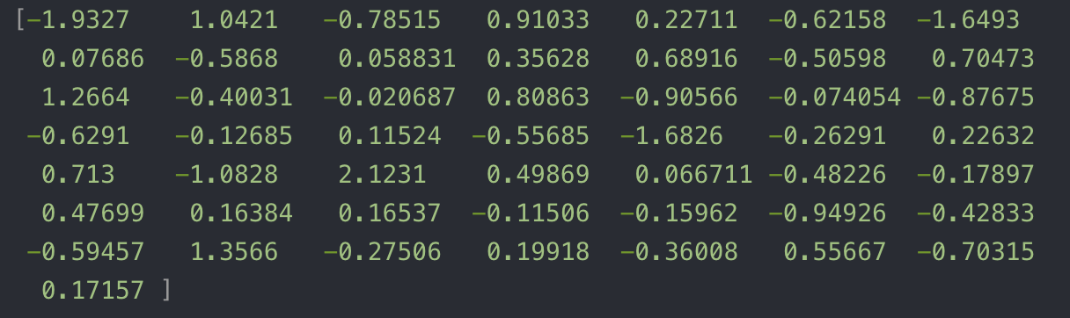
Vector representations of words
Problem statement: let machine understand the input text
One application of NLP
Use the model "Glove":
Input word: "king"; output:

Slide 18
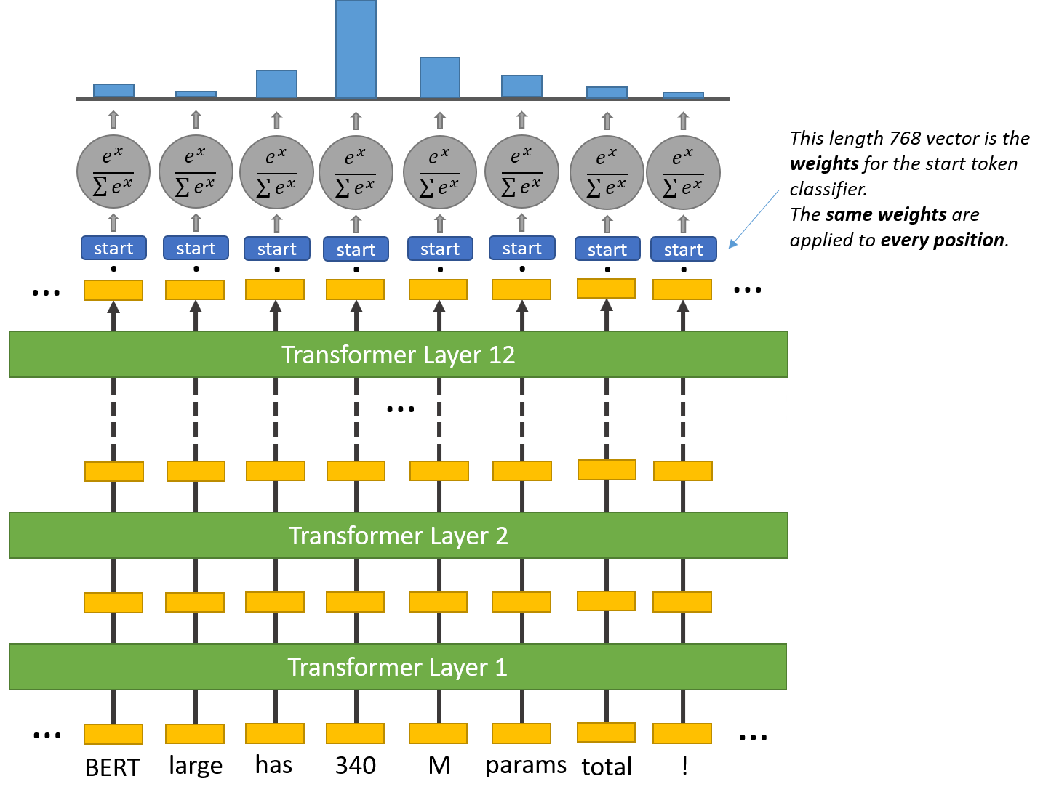
BERT Question and Answer Model
Problem Statement: Find the segment of the passage that best answers a reading comprehension question
Denoted by the start and end word
BERT model produces individual confidence levels for start and end tokens
Pick the most confident start, and the most confident end that occurs after the start
Bert LARGE
BERT official paper: https://arxiv.org/pdf/1810.04805.pdf
BERT architecture diagram: https://towardsdatascience.com/bert-explained-state-of-the-art-language-model-for-nlp-f8b21a9b6270

Slide 19
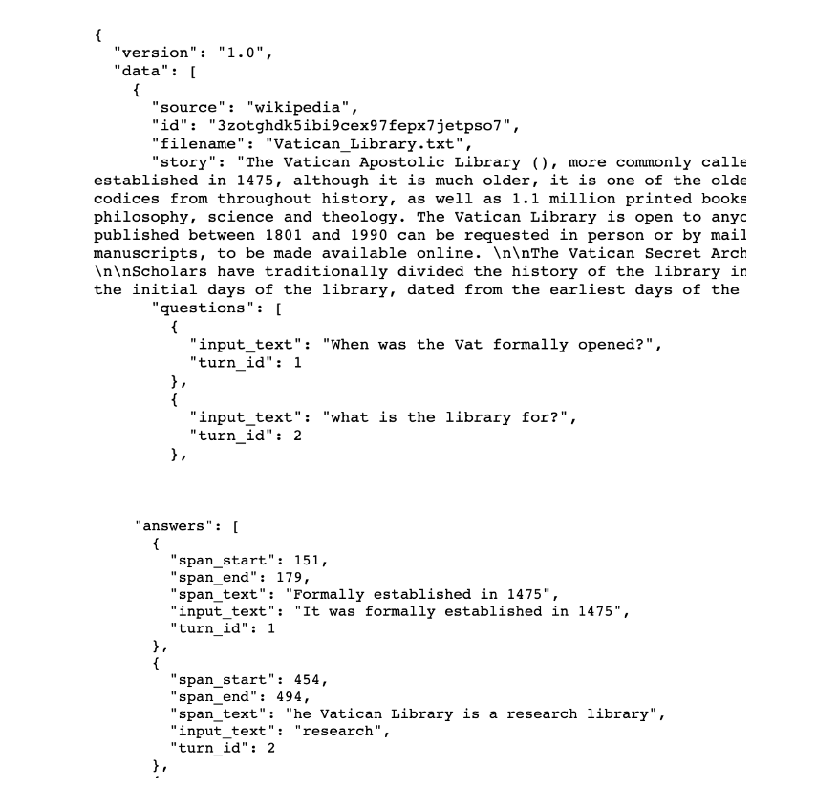
Fine-Tuning BERT
Less expensive than pre-training
Provide labeled data to the fine-tuning algorithm described in the BERT paper
BERT fine-tuning data format: https://towardsdatascience.com/question-answering-with-a-fine-tuned-bert-bc4dafd45626

Slide 20
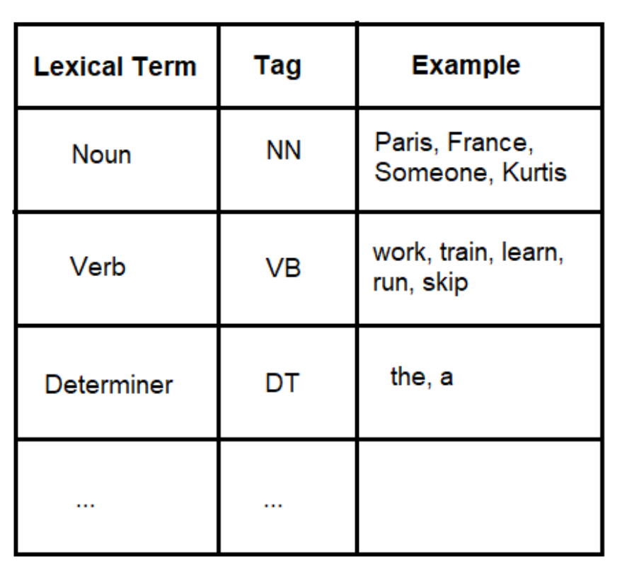
Search Analytics
Part-of-speech tagging – breakdown search entry into segment in terms of grammatical meanings.
Keyword plotting – plotting keyword search frequency on a time scale, provide feedback to other teams and instructors.
User behavior – how webex bot is accessed and how frequent it is being used.

Slide 21
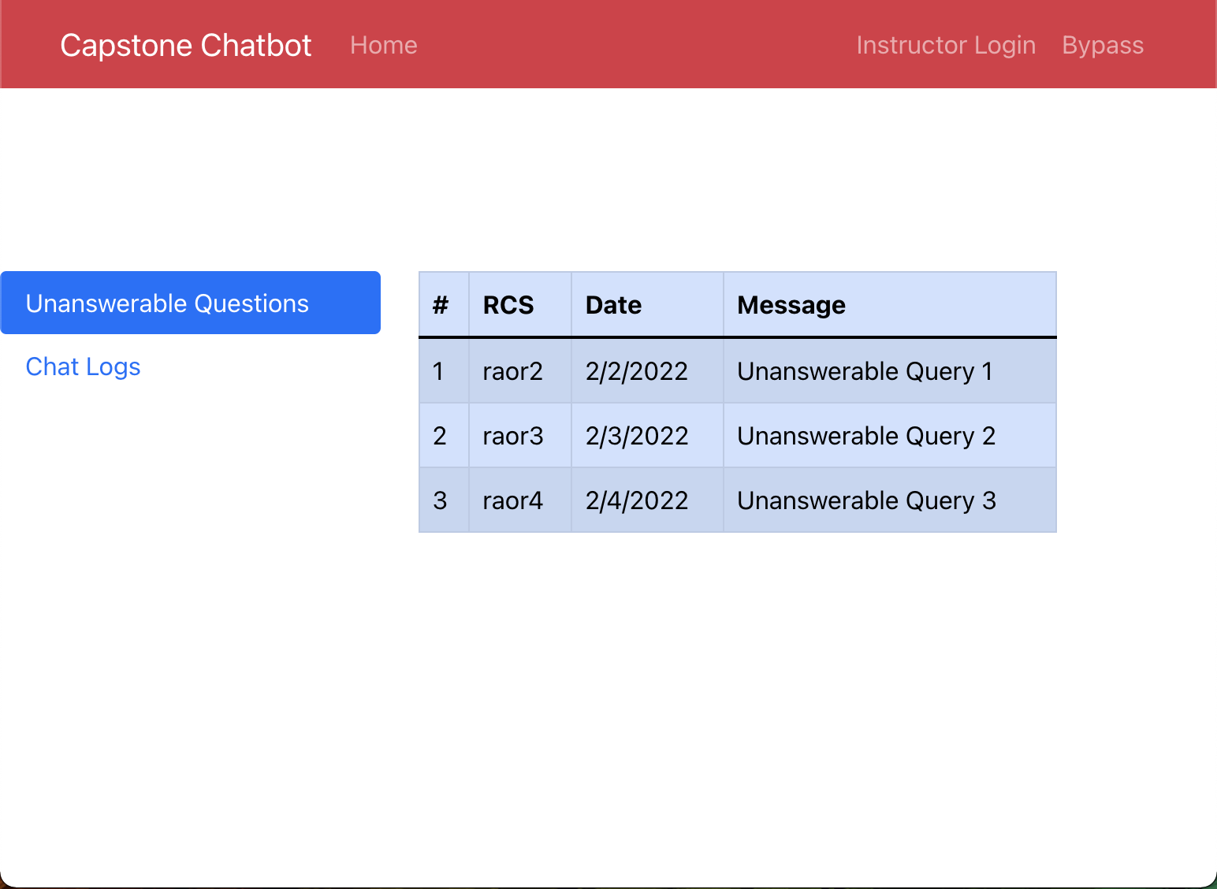
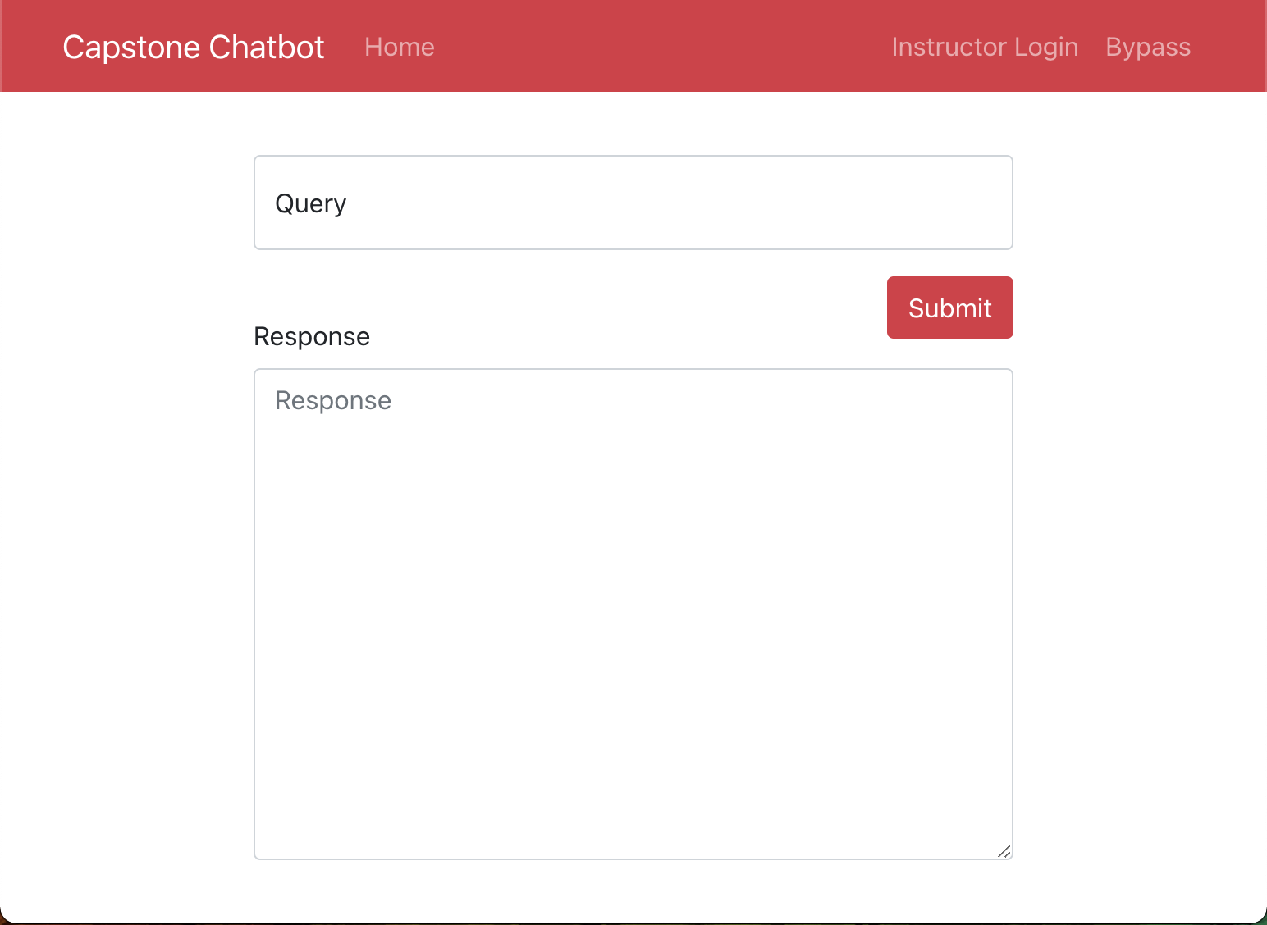
Next Steps
Webex front end is in progress
Requires approval
Has stricter regulations
Run by RPI
React Front end
Rapid development
Once connected to python backend can be used for full stack testing
Can be swapped out with Webex front end later

Slide 22
Next Steps – Continued
Search analytics
Researching algorithm to provide in depth analysis to search keywords and user analysis.
Testing on small user input – from within the team before integrating it into the actual webex chatbot
Backend
Develop server to interact with Webex API
Possibly test speed of prototype HTTP webhook vs. WebSocket bot
Integrate server with Q&A system

Slide 23
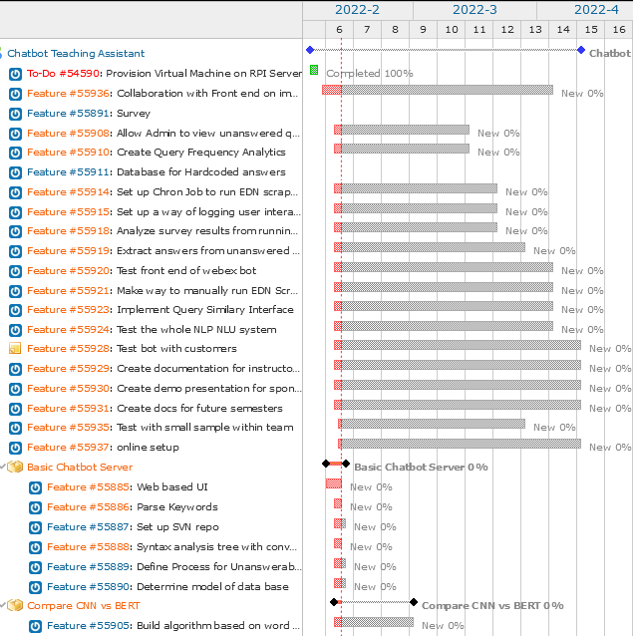
Next Steps – Gantt Chart

Slide 24
Current Challenges
Getting labeled data that is representative of the EDN wiki for learning
Cleaning the scraped EDN data
Convert tables and lists to sentences
Approval from RPI Division of the CIO for chatbot integration with Webex

